Slide 1






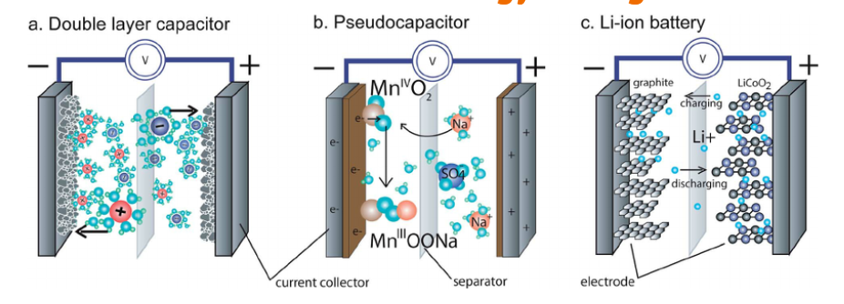
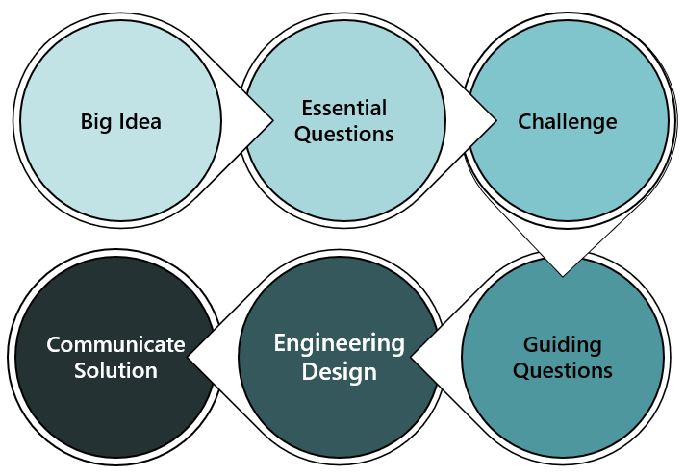



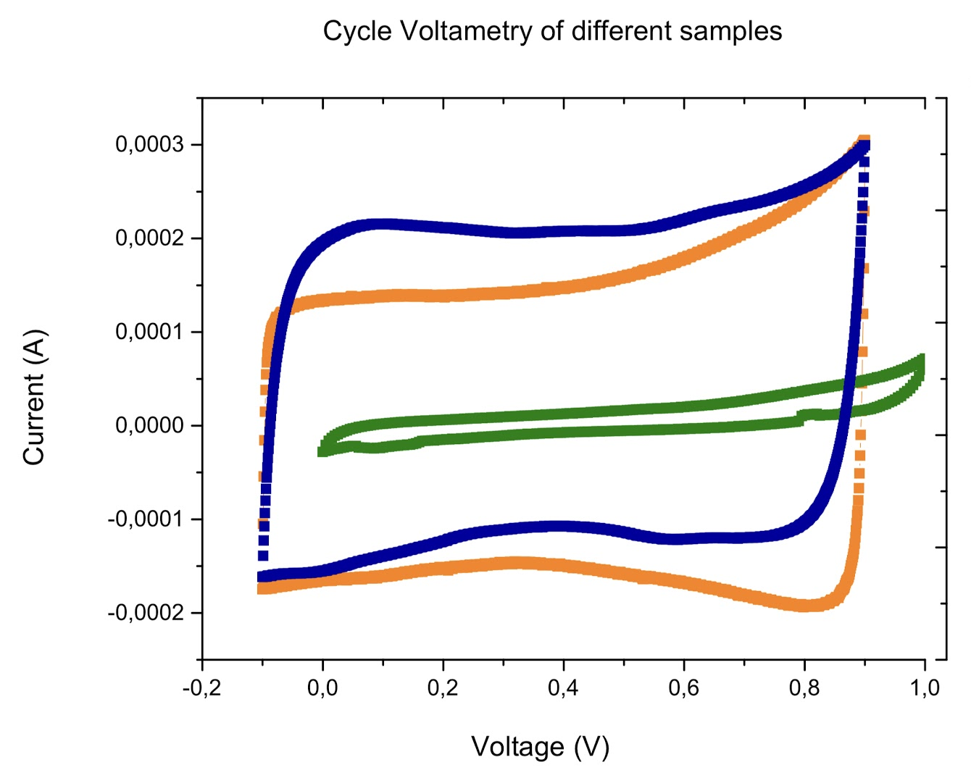


Optimizing Everyday Objects
Ramya Ravindrababu
Betsy Layne High School, Geometry
RET is funded by
the National Science Foundation, grant
# EEC-1710826
Summer Study |  | Classroom Impact |  | Research Significance
Why is Energy Storage important?
How can Engineering be used to optimize everyday products?
You Can be an Engineer
There is a common misconception that every day objects have already been refined and optimized by “professionals”. The reality is that anyone can have a hand in engineering a better world & redesigning everyday objects.
Mechanisms of Energy Storage
Student Driven Inquiry
Engineering is Everywhere
Goal: Create a Better Battery
Student input shapes the investigation
Multiple valid strategies & solutions
Sharpen 21st century skills

